Slide 1
Premier League Report (2023-2024)
By : Ahmed Bedair

Slide 2
Introduction
Well, The premier League is back so I decided to make an overall report about Season (2023-2024) in Premier league to identify stats about the premier league teams and attendance to identify how to improve matches attendance and How to benefit from the top 6 teams’ (Arsenal – Liverpool – Manchester United – Manchester City – Chelsea – Tottenham Hotspur) popularity by analyzing their stats in each schedule

Slide 3
Project Goals and KPIS
What do we want from this Project

Slide 4
Project Goals and KPIS
Identifying overall season stats
Compare between top 6 teams and other teams
Exploring Relations Between Matches Schedule and attendance
Exploring Relations Between Matches Schedule and Teams Stats

Slide 5
Steps Before Dashboard
What did we do before getting the final Result?

Slide 6
Steps Before Dashboard
Before We made our Dashboard to visualize our data, we’ve made some steps to make our data ready for dashboarding stage :
Data Importing and Exploration
Checking Nulls and duplicates
Dropping unnecessary columns
Imputing and removing nulls and duplicates
Splitting Matches times into 6 Schedules (Early, Regular , Midweek, Occasional, Evening and late)
Splitting teams to top 6 teams and other teams as we explained Before

Slide 7
Steps Before Dashboard
Note : Before We go to the dashboard stage, I’ve to explain Matches schedule to determine the best times for matches for attendance and stats the makes the matches more amazing :
1- Early: Saturdays and Sunday matches that starts before 3:00 PM
2- Regular: Saturdays matches that starts before 5:30 PM and after 3:00 PM
3- Evening: Saturdays matches that starts before 8:00 PM and after 5:30 PM
4- Late: Saturdays matches that starts after 8:00 PM and Sunday matches that starts after 3:00 PM
5- Midweek : Matches that starts in Tuesdays and Wednesdays
6- Occasional : Matches that starts in the other days ( Happens rarely)

Slide 8
Dashboards Pages
We’ve here 3 pages for premier league stats
Schedule overall stats
Overall teams stats
Top 6 Schedule stats

Slide 9
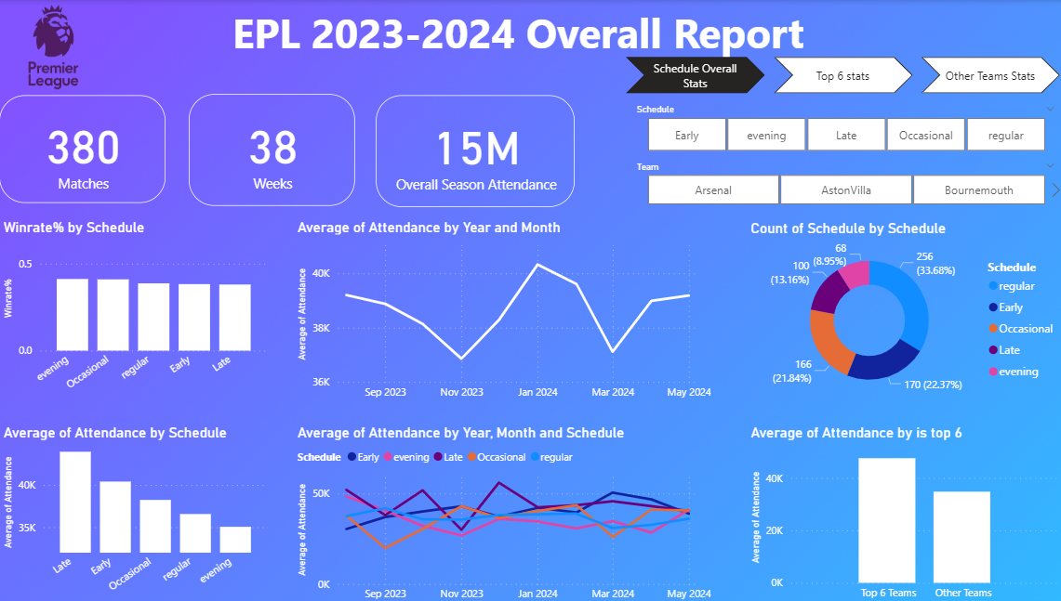
Schedule overall stats

Slide 10
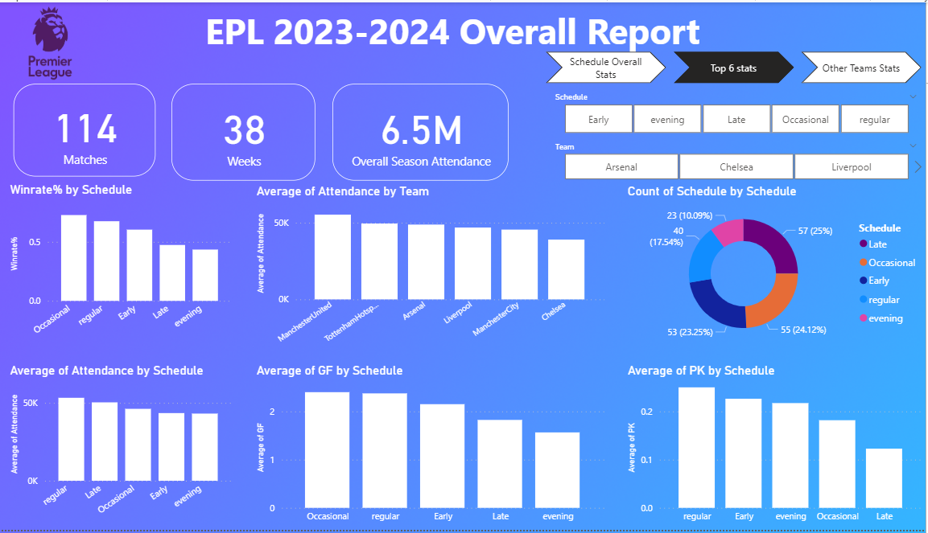
Top 6 stats

Slide 11
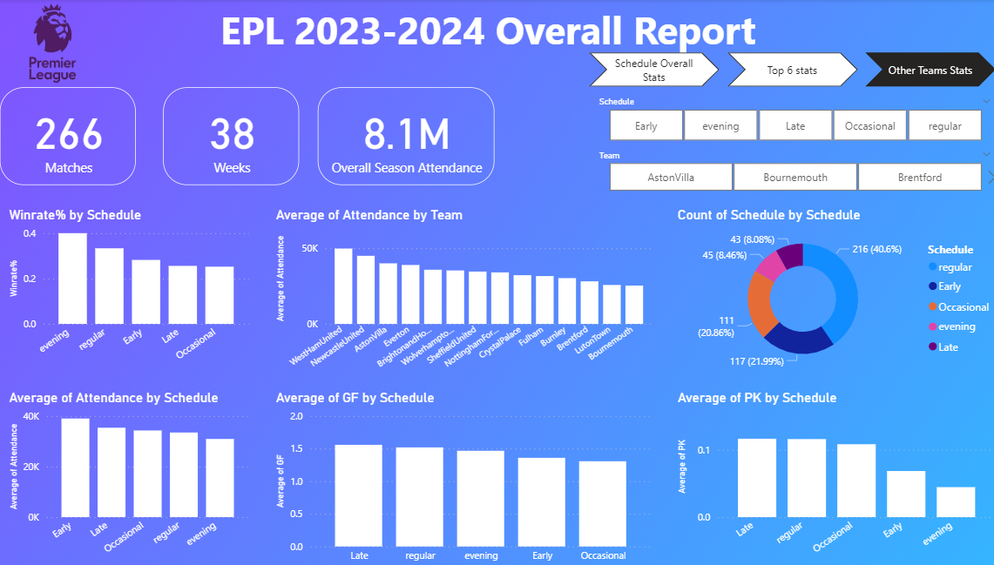
Other teams stats

Slide 12
Dashboards Explanations
What do these graphs symbolize?

Slide 13
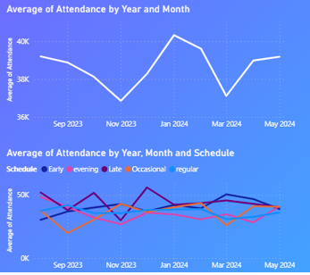
Seasonality of Attendance
Attendance ranges 36K–41K with seasonal fluctuations.
Lowest dips: Nov 2023 and Mar 2024.
Peak: Jan 2024 (~41K), likely holiday or key fixtures.
Regular games: most stable (~45K–50K across year).
Evening games: stable but slightly below Regular.
Late & Occasional games: volatile, driving dips.
Seasonality Takeaway: Peaks in Jan, lows in Nov/Mar.

Slide 14
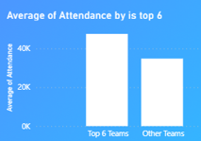
Top 6 Vs Other teams
We can find here that the top 6 Teams have more attendance than other teams so we’ve added two more pages to out main page to compare between top 6 team and the others

Slide 15
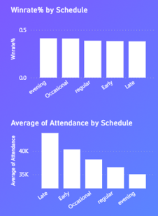
Impact of Schedule on Winrate & Attendance
We can find here that the late and early matches are the top popular matches even they have the least win rate % that The team plays better during early or nightly schedules, even though attendance is lower.

Slide 16
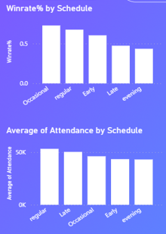
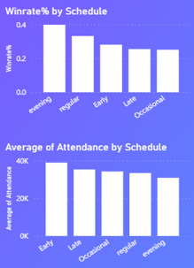
Impact of Schedule on Winrate & Attendance (Top 6 Vs Others)
Top 6
Other Teams
We can find here that the stats doesn’t differ too much from the overall stats Except in little points
Occasional top 6 matches have the most win rate% but the opposite for other teams
Regular matches is better in attendance for top 6 matches and the win rate too
Evening matches is better in attendance for top 6 matches and the win rate too

Slide 17
Final Conclusions
Attendance shows seasonal peaks in January and dips in November & March.
Late games attract the largest crowds but result in lower win rates.
Evening and regular games deliver stronger team performance despite smaller attendance.
Top 6 teams consistently draw higher attendance and perform better in Regular & Evening matches.
Late & Occasional matches are volatile, causing fluctuations in attendance.

Slide 18
Recommendations
How to improve EPL Experience for audience and enhancing tickets sales

Slide 19
Recommendations
Capitalize on January peaks with premium packages & sponsorships.
Boost November & March attendance using discounts & fan engagement.
Enhance Late games with entertainment value (shows, influencers).
Promote Evening & Regular games as high-performance matches.
Treat Top 6 matches as marquee events with exclusive marketing.
Stabilize Occasional matches via dynamic pricing & community outreach.

Slide 20
Thank You

